Slide 1

ETL WORKFLOW AUTOMATION
-By Nevetha S K

Slide 2


Table of Contents
Project Statement
Project Overview
Prerequisites
Azure Resources Used
Project Objectives
Tools Used
Execution Overview
Implementation - Tasks Performed
Practical Implementation on Azure Portal
Successful Output Generated
Strategies that can be used in Optimizing ETL Workflow
Conclusion

Slide 3
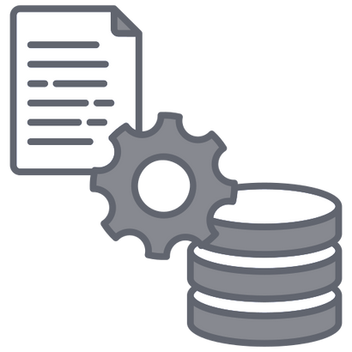
Project Statement
Build an end-to-end ETL (Extract, Transform, Load) workflow using Azure Data Factory to orchestrate data movement and transformation, and leverage Azure Databricks for complex data transformations using Spark.

Slide 4
The project integrates multiple Azure services to build a scalable, reliable, and optimized ETL process.
Project Overview
The raw CSV dataset is cleaned and transformed into an analytics-ready format for reporting and insights.

Slide 5



Azure Subscription – For resource management
Resource Group – Logical container for resources
Azure Storage Account – Data Lake Gen2 enabled
Azure Data Factory (ADF) – Pipeline orchestration
Azure Databricks – Spark-based processing workspace
Databricks Cluster – Runs PySpark/Spark SQL jobs
Access Keys – Authentication to storage
Data Source – Input CSV file availability
Prerequisites

Slide 6

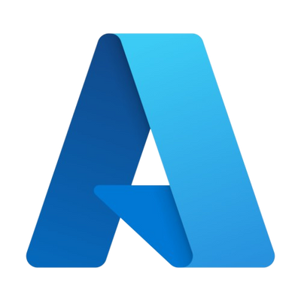
Azure Resources Used
Azure Blob Storage
Azure Data Factory
Azure Storage Account
Copy Data Activity
Databricks Notebook Activity

Slide 7
--Build an automated ETL pipeline by leveraging Azure cloud services for seamless data integration and management.
--Apply data cleansing and transformation logic using PySpark to ensure accurate and reliable data processing.
--Optimize storage by saving transformed data in Parquet format, enabling efficient querying and analytics.
--Enforce strong data quality measures such as deduplication, null value handling, and schema validation.
Project Objectives

Slide 8
Tools Used
Azure Data Factory (Orchestrator): ADF will serve as the orchestration tool, defining a pipeline with two stages.
Copy Activity: This stage will utilize the Azure Blob Storage or Azure Data Lake Storage linked service to copy the CSV files from the source container to a temporary folder in Azure Storage.
Databricks Notebook Activity: This stage will trigger a Databricks notebook that reads the copied CSV files, transforms them into Parquet format, and writes the new files to the final destination location (e.g., Azure Data Lake Storage Gen2).
Azure Databricks (Data Processing Workspace): Databricks notebooks are used to implement data cleansing, transformation, and schema validation using PySpark. The processed data is then written in Parquet format for optimized storage and analytics.

Slide 9
Execution Overview
1
2
3
4
Bronze Zone – Raw Data CSV uploaded to Data Lake, stored in original format.
ADFPipeline Orchestration- Automates ETL, triggers Databricks notebooks for processing.
Silver Zone – Cleansing & Transformation: Data cleaned (duplicates, nulls, formats) and stored as Parquet.
GoldZone– Aggregation& Analytics:Business-ready datasets prepared with summaries, joins, and stored for BI use.

Slide 10





Created a resource group with Data Lake Gen2 storage and organized Bronze, Silver, and Gold zones.
Uploaded the raw dataset (CSV) into the Bronze zone.
Configured Databricks workspace and cluster, and developed a PySpark notebook for data cleansing and transformation.
Implementation - Tasks Performed
Orchestrated the ETL workflow using Azure Data Factory with Linked Services and a Databricks Notebook Activity.
Executed the pipeline successfully and validated curated Parquet output in the Silver zone.

Slide 11

Provision Resources (Resource Group + ADLS Gen2 + Upload Data)
Steps On Practical Implementation On The Azure Portal
Set Up Databricks (Workspace & Cluster)
Build ADF Pipeline (Data Factory + Linked Services)
Add Activities (Copy Data + Notebook)
Orchestrate & Run (Connect & Trigger Pipeline)

Slide 12
Create Resource Group
Acts as a logical container for all Azure services.
Helps manage, monitor, and control costs in
one place.
Create Storage Account (ADLS Gen2)
Provides hierarchical namespace for big data analytics.
Optimized for high-throughput and secure data storage.
Upload Raw Dataset
Place raw .csv files into a container (Raw Zone).
Acts as the landing zone for all ingestion pipelines.
STEP 1
Provision Resources

Slide 13
Create Azure Databricks Workspace
Centralized environment to run Spark jobs and manage notebooks.
Configure & Launch Cluster
Cluster = group of VMs to process big data in parallel.
Choose runtime, autoscaling, and worker node size.
Test Connection
Validate workspace connectivity with ADLS Gen2 storage.
STEP 2
Set Up Databricks

Slide 14
Create Azure Data Factory (ADF)
The orchestration engine that manages ETL workflows.
Configure Linked Services
ADLS Gen2 Linked Service → To access raw & curated data.
Databricks Linked Service → To run notebooks for transformation.
Integration Runtime Setup
Enables secure data movement between services.
STEP 3
Build ADF Pipeline

Slide 15
Copy Data Activity
Extract data from ADLS (Raw Zone).
Load it into another container (Silver Zone /
Curated Zone).
Notebook Activity
Triggers Databricks notebooks for data cleaning, transformations, or aggregations.
Pass parameters (like file path, date) to notebooks for flexibility.
Activity Connection
Link activities in sequence to ensure smooth flow (Copy → Notebook).
STEP 4
Add Activities

Slide 16
Connect Activities
Build workflow logic (sequential or parallel execution).
Add Triggers
Manual Trigger → Run on-demand.
Schedule Trigger → Run at fixed intervals
(e.g., hourly, daily).
Event Trigger → Start when a file arrives
in ADLS.
Monitor Pipeline
Use ADF monitoring tools for run history, logs, and error handling.
Validate & Publish
Validate pipeline design, then publish changes to make them active.
STEP 5
Orchestrate & Run

Slide 17
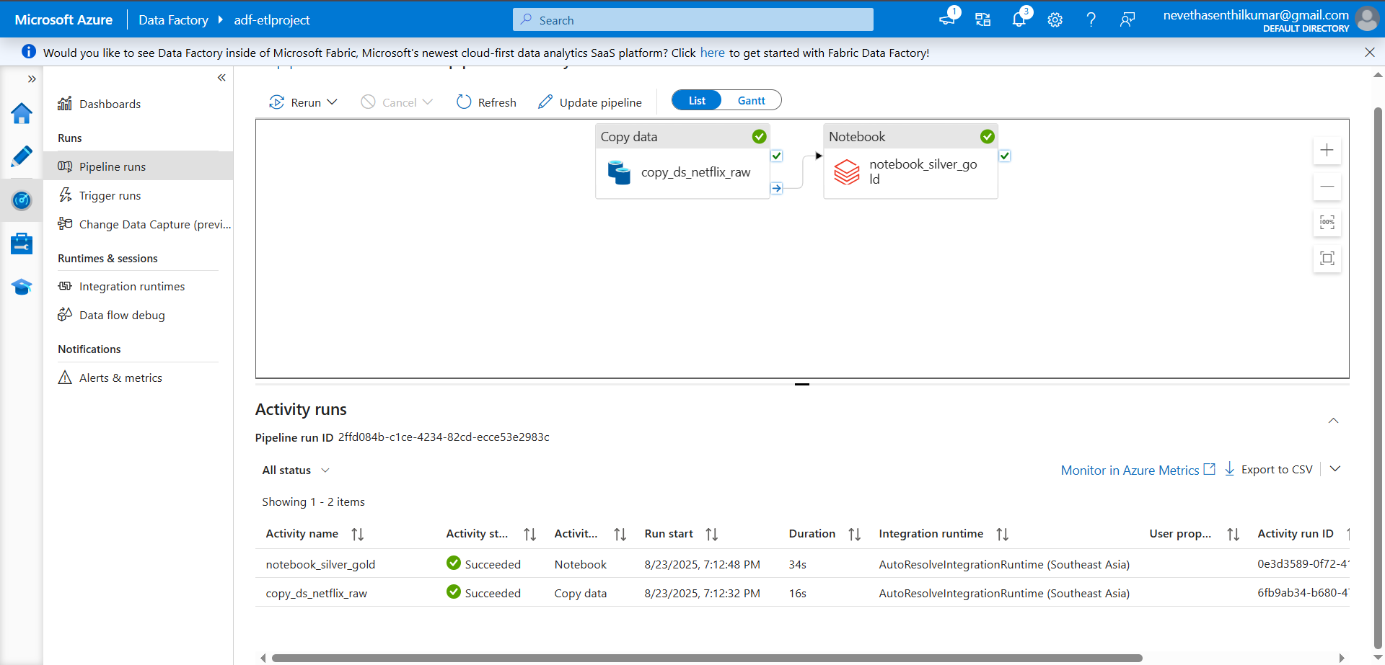
Successful Output Generated

Slide 18
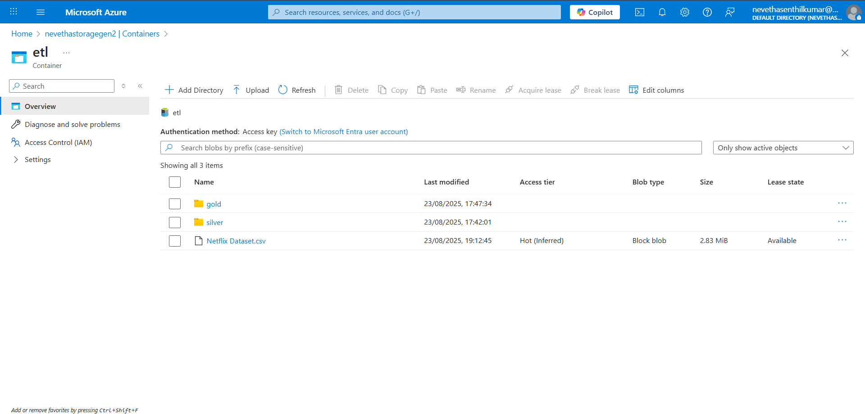
Successful Output Generated

Slide 19
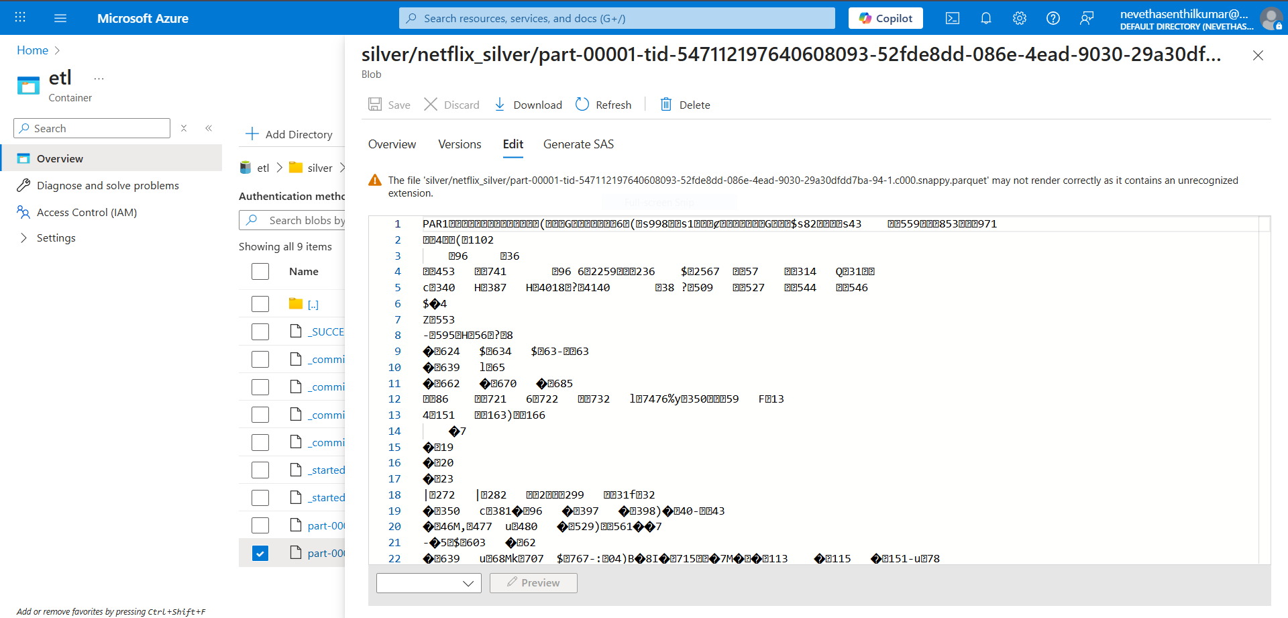
Successful Output Generated

Slide 20
1. Efficient Data Ingestion
Use incremental loads (Watermark/
LastModifiedDate).
Enable parallelism in ADF copy activities.
Compress input files (Gzip/Snappy).
2. Data Transformation Optimization
Store data in Parquet/Delta instead of CSV.
Use Auto Optimize & Z-Ordering in
Databricks.
Prefer Spark SQL over Python UDFs.
3. Pipeline Orchestration
Build modular pipelines (ingest → stage →
transform → load).
Use ADF triggers for scheduling.
Add retry & error handling for resilience.
Strategies That Can Be Used In Optimizing The
Conversion Process

Slide 21
4. Scalability & Performance
Enable Databricks autoscaling clusters.
Partition datasets on query-heavy columns.
Cache intermediate results to save time.
5. Monitoring & Debugging
Set ADF monitoring alerts (Azure Monitor).
Store execution metadata (row counts, errors).
Apply data validation checks post-transformation.
6. Cost Optimization
Auto shut down idle clusters.
Use reserved capacity pricing.
Optimize storage tiers (Hot/Cool/Archive).
Strategies That Can Be Used In Optimizing The Conversion Process

Slide 22
Conclusion
The project successfully demonstrated the end-to-end automation of an ETL workflow using Azure services.
Leveraged Azure Data Factory for orchestration, Databricks for scalable transformations, and ADLS Gen2 for secure data storage.
Automated pipeline ensures seamless data ingestion, transformation, and loading with minimal manual intervention.
Achieved a robust, scalable, and cost-effective solution suitable for handling enterprise data workloads.
The framework provides a strong foundation for future enhancements such as real-time streaming, advanced analytics, and ML integration.

